Slide 1
Tree
Attributes

Slide 2
A Full
BINARY TREE
A full / proper binary tree is strictly binary, i.e. every node has exactly two children or no children at all.
Equivalently: every parent is full.
Notes:
Theorems: Let T be a nonempty, full binary tree. Then:
(a) If T has I internal nodes (i.e. parent nodes), the number of leaves is L = I + 1.
(b) If T has I internal nodes, the total number of nodes is N = 2I + 1.
(c) If T has a total of N nodes, the number of internal nodes is I = (N – 1)/2.
(d) If T has a total of N nodes, the number of leaves is L = (N + 1)/2.
(e) If T has L leaves, the total number of nodes is N = 2L – 1.
(f) If T has L leaves, the number of internal nodes is I = L – 1.

Slide 3
A Full
BINARY TREE
Full binary tree theorem: The number of leaves is always one more than the number of parents (a.k.a. internal nodes).
L = P + 1
P = L – 1
Leaves = Parents + 1
Parents = 2
Leaves = 3
Total nodes = 5
Notes:
Theorems: Let T be a nonempty, full binary tree. Then:
(a) If T has I internal nodes (i.e. parent nodes), the number of leaves is L = I + 1.
(b) If T has I internal nodes, the total number of nodes is N = 2I + 1.
(c) If T has a total of N nodes, the number of internal nodes is I = (N – 1)/2.
(d) If T has a total of N nodes, the number of leaves is L = (N + 1)/2.
(e) If T has L leaves, the total number of nodes is N = 2L – 1.
(f) If T has L leaves, the number of internal nodes is I = L – 1.

Slide 4
A Full
BINARY TREE
Full binary tree theorem 2: The number of parents (a.k.a. internal nodes) is always half of one less than the number of nodes.
P = (N – 1) / 2
N = 2 * P + 1
Parents = 2
Leaves = 3
Total nodes = 5
L = ????????
Notes:
Theorems: Let T be a nonempty, full binary tree. Then:
(a) If T has I internal nodes (i.e. parent nodes), the number of leaves is L = I + 1.
(b) If T has I internal nodes, the total number of nodes is N = 2I + 1.
(c) If T has a total of N nodes, the number of internal nodes is I = (N – 1)/2.
(d) If T has a total of N nodes, the number of leaves is L = (N + 1)/2.
(e) If T has L leaves, the total number of nodes is N = 2L – 1.
(f) If T has L leaves, the number of internal nodes is I = L – 1.

Slide 5
A Full
BINARY TREE
P = (N – 1)/2
L – 1 = (N – 1)/2
L = (N – 1)/2 + 1
L = (N – 1)/2 + 2/2
L = (N – 1 + 2)/2
L = (N + 1) / 2
L = P + 1
P = L – 1
Parents = 2
Leaves = 3
Total nodes = 5
Notes:
Theorems: Let T be a nonempty, full binary tree. Then:
(a) If T has I internal nodes (i.e. parent nodes), the number of leaves is L = I + 1.
(b) If T has I internal nodes, the total number of nodes is N = 2I + 1.
(c) If T has a total of N nodes, the number of internal nodes is I = (N – 1)/2.
(d) If T has a total of N nodes, the number of leaves is L = (N + 1)/2.
(e) If T has L leaves, the total number of nodes is N = 2L – 1.
(f) If T has L leaves, the number of internal nodes is I = L – 1.

Slide 6
A Full
BINARY TREE
N = 2P + 1
P = (N – 1) / 2
L = (N + 1) / 2
N = 2L – 1
Parents = 2
Leaves = 3
Total nodes = 5
Notes:
Theorems: Let T be a nonempty, full binary tree. Then:
(a) If T has I internal nodes (i.e. parent nodes), the number of leaves is L = I + 1.
(b) If T has I internal nodes, the total number of nodes is N = 2I + 1.
(c) If T has a total of N nodes, the number of internal nodes is I = (N – 1)/2.
(d) If T has a total of N nodes, the number of leaves is L = (N + 1)/2.
(e) If T has L leaves, the total number of nodes is N = 2L – 1.
(f) If T has L leaves, the number of internal nodes is I = L – 1.

Slide 7
Tree Attributes
90
50
120
40
65
100
150
30
45
70
95

Slide 8
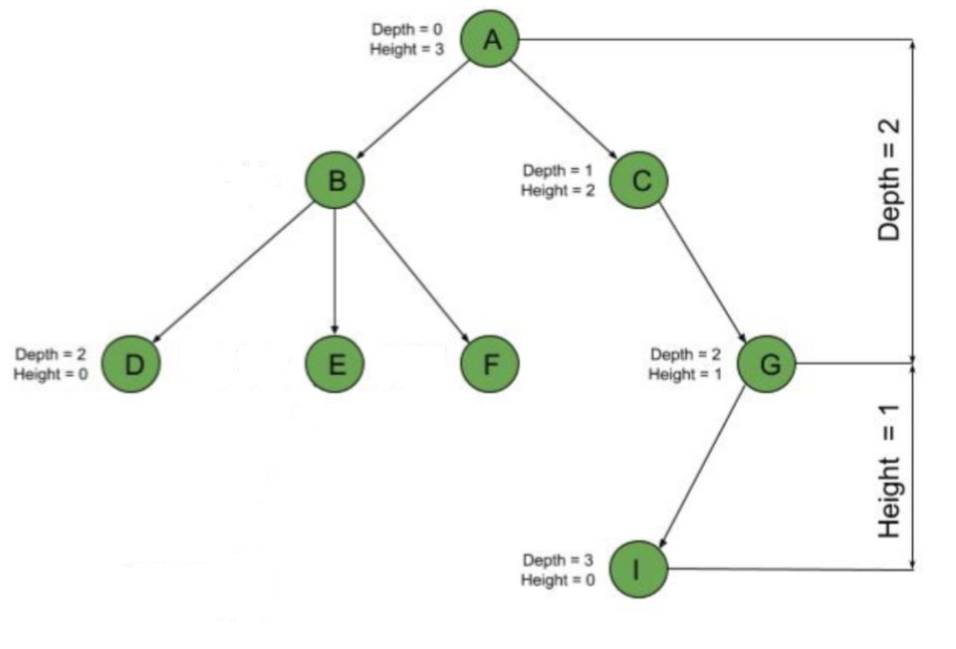
Depth of a node: # of edges from the root to the node.
Depth = 0
Height = 3
Depth = 1
Height = 1
Depth = 1
Height = 2
Depth = 2
Height = 0
Depth = 2
Height = 1
Height of a node: # of edges from the node to the deepest leaf in the leaf’s subtree.
Depth = 3
Height = 0

Slide 9
Height
90
50
120
40
65
100
150
30
45
70
95
HEIGHT - 3
Height = # of edges from root to lowest leaf
Notes:
The maximum distance of any node from the root. If a tree has only one node (the root), the height is zero. The height of an empty tree is not defined.

Slide 10
Diameter
90
50
120
40
65
100
150
30
45
70
95
Diameter = 6
Diameter = the number of edges on the longest path between two nodes in the tree (does not have to go through the root!)

Slide 11
Diameter
90
50
40
65
30
45
70
Diameter = 4

Slide 12
Printing a
Search Tree

Slide 13
Level Order
90
50
120
40
65
100
150
30
45
70
Level order (i.e. one level at a time):
90 50 120 40 65 100 150 30 45 70
System.out.println(tree);

Slide 14
Tree Traversals
90
50
120
40
65
100
150
30
45
70
IN-ORDER Traversal:
Left branch, Node, Right branch
30 40 45 50 65 70 90 100 120 150

Slide 15
Tree Traversals
90
50
120
40
65
100
150
30
45
70
PRE-ORDER Traversal:
Node, Left branch, Right branch
90 50 40 30 45 65 70 120 100 150

Slide 16
Tree Traversals
90
50
120
40
65
100
150
30
45
70
POST-ORDER Traversal:
Left branch, Right branch, Node
30 45 40 70 65 50 100 150 120 90

Slide 17
Tree Traversals
90
50
120
40
65
100
150
30
45
70
REV-ORDER Traversal:
Right branch, Node, Left branch
150 120 100 90 70 65 50 45 40 30

Slide 18
Why?
Use pre-order traversal to duplicate a binary tree.
In-order traversal is very commonly used on binary search trees because it returns values from the underlying set in order, according to the comparator that set up the binary search tree (hence the name).
Post-order traversal while deleting or freeing nodes and values can delete or free an entire binary tree. If you don't use post-order traversal during deletion, then you lose the references you need for deleting the child trees

Slide 19
Why?
To translate between the tree and some serial representation. Suppose you have this parse tree:
*
/ \
+ \
/ \ \
A B C
You could serialize it as:
* + A B C by walking it in prefix order, or as
A B + C * by walking it in postfix order or as
(A + B) * C by walking in order.

Slide 20
In Order 1
public void inOrder() {
inOrder(root);
}
private void inOrder(TreeNode tree) {
if (tree != null){
inOrder(tree.getLeft());
out.print(tree.getValue() + " ");
inOrder(tree.getRight());
}
}
LEFT
DATA
RIGHT

Slide 21
In Order 2
public void inOrder() {
inOrder(root);
}
private void inOrder(TreeNode tree) {
if (tree == null){ return;
}
inOrder(tree.getLeft());
out.print(tree.getValue() + " ");
inOrder(tree.getRight());
}
LEFT
DATA
RIGHT

Slide 22
toString
public String toString()
{
return toString(root);
}
private String toString(TreeNode tree)
{
if (tree != null)
return toString(tree.getLeft()) + " "
+ tree.getValue() + " " +
toString(tree.getRight());
return "";
}
Data is in the MIDDLE!!!

Slide 23
Binary Tree Traversals
In-Order
LEFT
DATA
RIGHT
DATA
LEFT
RIGHT
Pre-Order
LEFT
RIGHT
DATA
Post-Order
RIGHT
DATA
LEFT
Reverse-Order

Slide 24
BigO

Slide 25
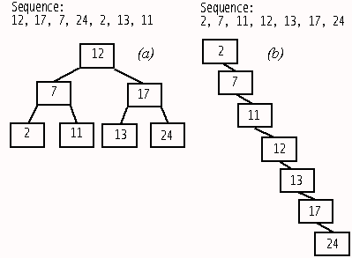
BST Big O
traverse all nodes O(N)
search for an item O(log₂N)
remove any item O(log₂N)
add item O(log₂N)
Average case
these results assume the tree is balanced or nearly balanced.
Notes:
A balanced binary tree is commonly defined as a binary tree in which the depth of the two subtrees of every node never differ by more than 1,^{[3]} although in general it is a binary tree where no leaf is much farther away from the root than any other leaf. (Different balancing schemes allow different definitions of "much farther"^{[4]}). Binary trees that are balanced according to this definition have a predictable depth (how many nodes are traversed from the root to a leaf, root counting as node 0 and subsequent as 1, 2, ..., depth). This depth is equal to the integer part of where is the number of nodes on the balanced tree. Example 1: balanced tree with 1 node, (depth = 0). Example 2: balanced tree with 3 nodes, (depth=1). Example 3: balanced tree with 5 nodes, (depth of tree is 2 nodes).

Slide 26
Worst case:
Data entered in natural order or reverse order.
Or any other tree with as many levels as nodes.
Adding O(n)
Searching O(n)
Removing O(n)

Slide 27
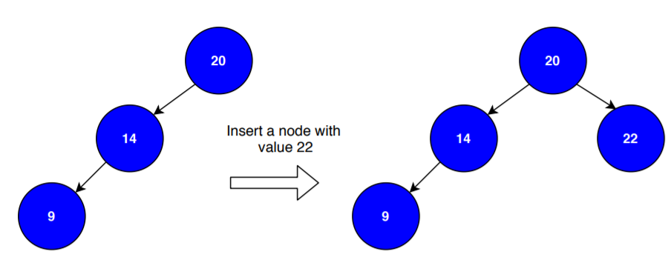
Best case = O(1)
Search value is the root
Adding to a tree with only one branch when the new value starts the other branch
Removing a node which has 0 or 1 child

Slide 28
Using a Sorted Array and the Binary Search Algorithm
traverse all nodes O(N)
search for an item O(log₂N)
remove any item O(N)
access a spot O(1)
add item O(N)
[2, 3, 5, 8, 10, 19, 23, 27, 32]
Notes:
A balanced binary tree is commonly defined as a binary tree in which the depth of the two subtrees of every node never differ by more than 1,^{[3]} although in general it is a binary tree where no leaf is much farther away from the root than any other leaf. (Different balancing schemes allow different definitions of "much farther"^{[4]}). Binary trees that are balanced according to this definition have a predictable depth (how many nodes are traversed from the root to a leaf, root counting as node 0 and subsequent as 1, 2, ..., depth). This depth is equal to the integer part of where is the number of nodes on the balanced tree. Example 1: balanced tree with 1 node, (depth = 0). Example 2: balanced tree with 3 nodes, (depth=1). Example 3: balanced tree with 5 nodes, (depth of tree is 2 nodes).

Slide 29
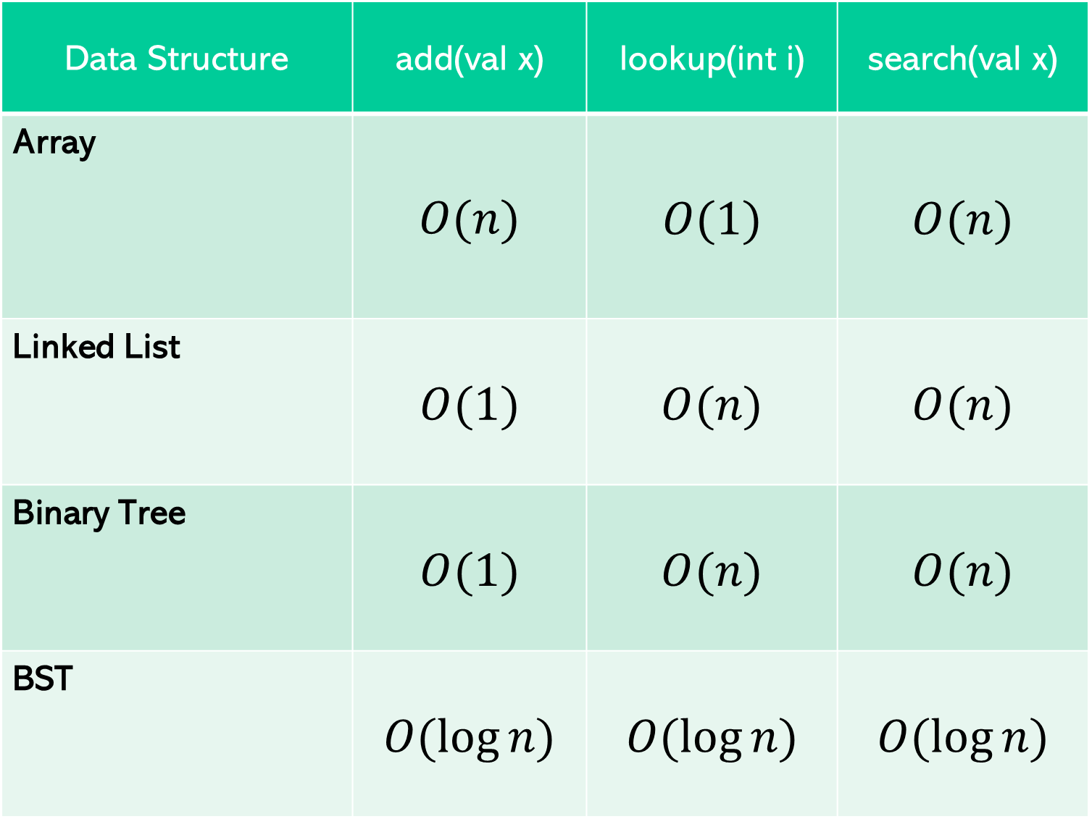
Comparing Data Structures
Data Structure | add(val x) | lookup(int i) | search(val x)
Array | $$O(n)$$ | $$O(1)$$ | $$O(n)$$
Linked List | $$O(1)$$ | $$O(n)$$ | $$O(n)$$
Binary Tree | $$O(1)$$ | $$O(n)$$ | $$O(n)$$
BST | $$O(\log{n})$$ | $$O(\log{n})$$ | $$O(\log{n})$$
2
1
3
0
2
1
3
0
1
2
3
2
1
3
Notes:
This slide is editable.

